Slide 1

College of Arts & Media
FY 2024 Planning and Budget Meeting

Slide 2
College of Arts & Media
Academic Departments
  Art
  Dance
  Mass Communication
  School of Music
  Theatre & Musical Theatre
Centers
  Center for Music Education
  Center for Early Music Research & Performance
  Center for Art Research & Education

Slide 3
FY 2023 Accomplishments
Priority 1: Prioritize Student Success and Student Access
  The Department of Mass Communication developed a fully online MA in Emerging and Social Media to provide flexible scheduling and modality.
  CAM Public Events – more than 200 public events with attendance more than 19K.
  The SHSU Opera workshop won 1st prize in the National Opera Associations Scenes competition in the undergraduate division and 2nd prize in the graduate division.

Slide 4
FY 2023 Accomplishments
Priority 2: Embody a Culture of Excellence
  The Texas State University System Board of Regents awarded School of Music student Mateo Seghezzo the Regents' Student Scholar Award.
  The College of Arts and Media hosted programs that promoted belonging among faculty, staff, and students (e.g. First Generation Celebration, CAM Welcome Back Event, etc.).
  CAM Public Events - featured events that mirror the diversity of our campus and local community.

Slide 5
FY 2023 Accomplishments
Priority 3: Elevate the Reputation and Visibility of SHSU
  Art and Social Practice MFA graduate students created the "Traveling Social Pharmacy" (a collaborative project) exhibited at various locations across the SHSU campus and the City of Huntsville.
  CAM Artist series
  CAM faculty and students continue to participate in Academic Community Engagement (ACE) classes.
  Ongoing collaboration to support the Vaccine Education Grant - $6.1 million

Slide 6
FY 2023 Accomplishments
Priority 4: Expand and Elevate our Service to the State and Beyond
  The University art spaces hosted guest lectures and exhibitions of contemporary art in a variety of media by artists from diverse backgrounds from across the United States, the state and regionally.
  The College of Arts and Media co-sponsored the Art + Biology + Community program, engaging local youth in interdisciplinary learning sessions.
  The Department of Dance hosted the American College Dance Association Festival which brought over 400 students from 22 universities to SHSU.

Slide 7
Budget Request
#1 Budget Priority | Art Faculty – (1) Ceramics Lecturer & (4) Visiting Assistant Professors
Aligned with Strategic Priority Goal | Strategy 1: Prioritize Student Success and Access. Goal 1.1 - Recruit, retain, graduate, and empower students to drive sustainable growth.
Amount Requested | $381,152
Frequency of Need | Recurring
Opportunity Statement | The continuation of the ceramics position and the addition of four visiting assistant professor positions for the Department of Art is essential to maintain and enhance the quality of instruction. Funding for these positions is necessary to ensure the continued growth of our art programs and to provide students with the skills and knowledge needed to succeed in their future careers. This is needed to meet enrollment demands.
Risk Statement | Failure to fund this request could result in decreased academic quality, reduced enrollment, and a loss of revenue. Lack of investment in the department could result in long-term damage to our academic standing, reputation, and financial stability.

Slide 8
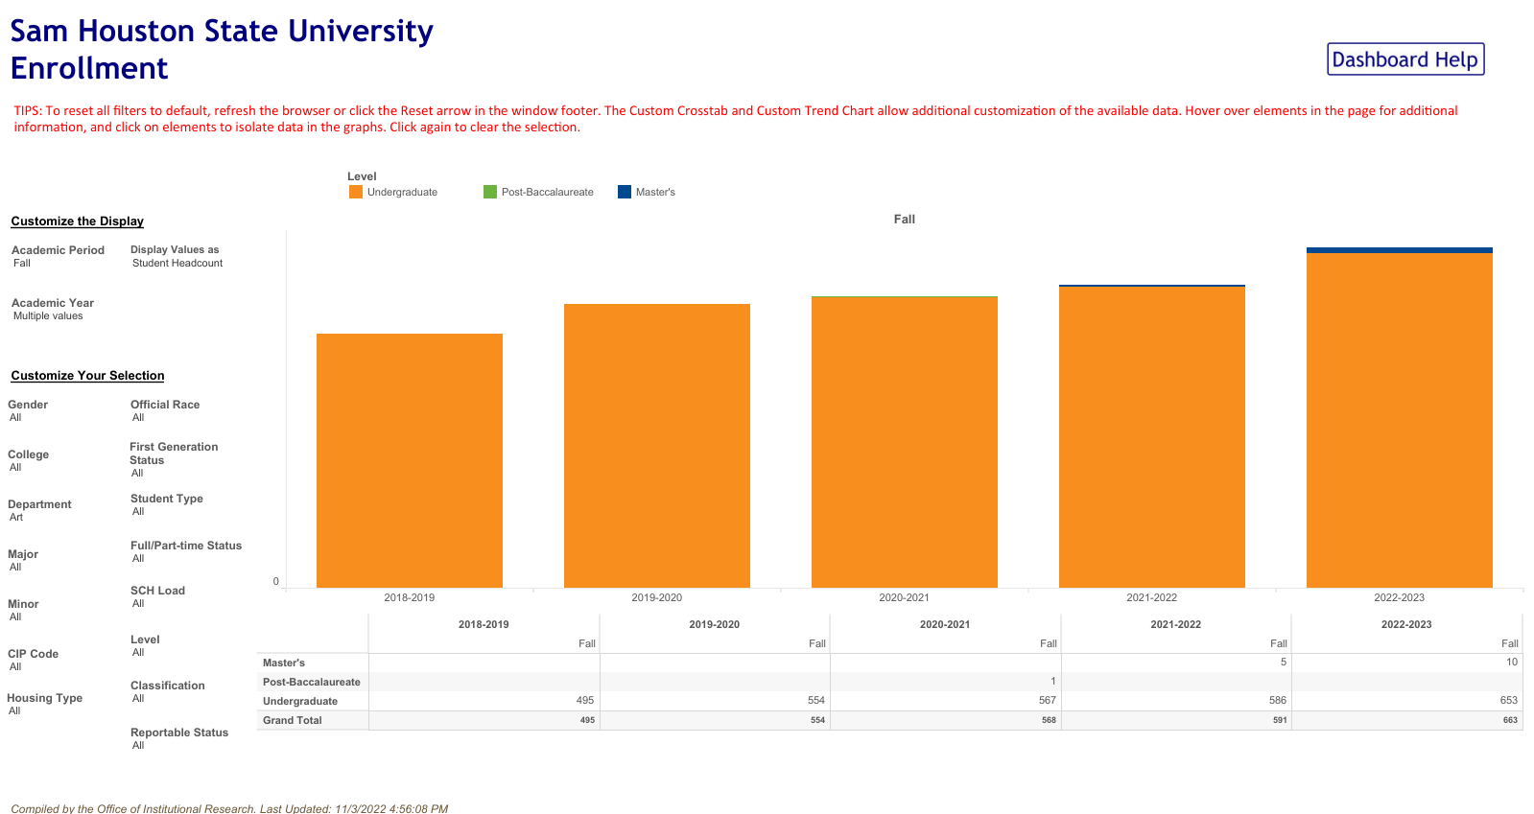
Supportive Data
25.3% enrollment growth

Slide 9
Budget Request
#2 Budget Priority
What is the request?
#2 Budget Priority | MCOM Faculty – Clinical Asst. Prof & Visiting Asst. Prof
Aligned with Strategic Priority Goal | Strategy 1: Prioritize Student Success and Access. Goal 1.1 - Recruit, retain, graduate, and empower students to drive sustainable growth.
Amount Requested | $157,841
Frequency of Need | Recurring
Opportunity Statement | These faculty positions are crucial for students to develop critical communication skills and provides them with the necessary training to excel in the media industry. These positions ensure students develop strong critical thinking, communication, and writing skills that are essential for a variety of careers in broadcast journalism, media, and communications. Needed to support current enrollments.
Risk Statement | Failure to fund these positions poses a significant risk of loss of revenue for the university. Without sufficient faculty, the university may not be able to offer the required courses and opportunities for students to graduate on time, leading to delays and potential loss of tuition revenue.

Slide 10
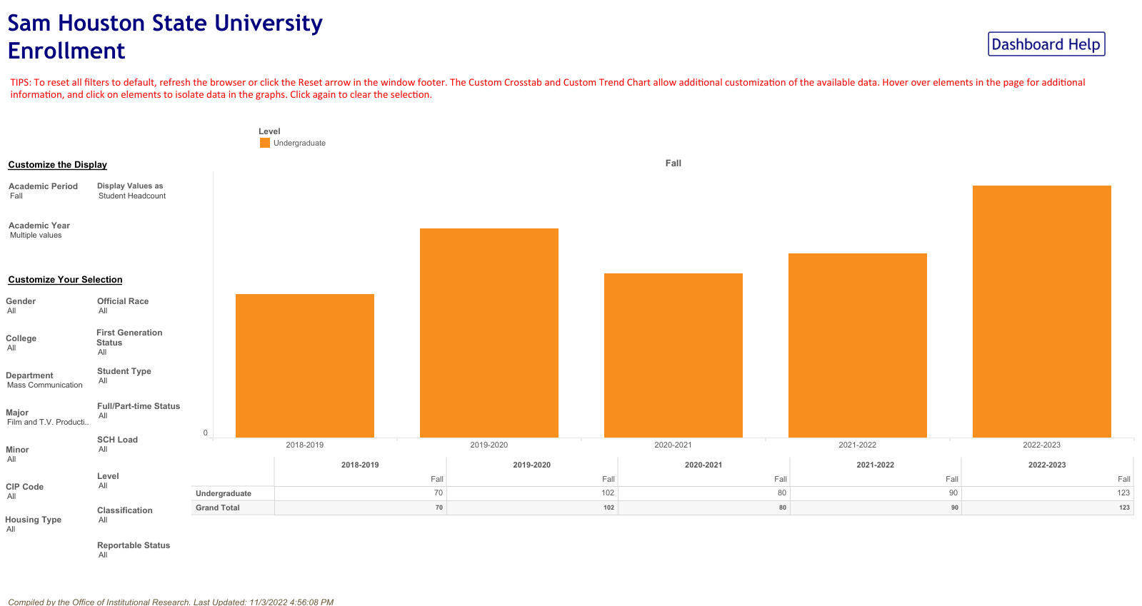
Supportive Data
43.0 % enrollment growth

Slide 11
Budget Request
#3 Budget Priority
What is the request?
#3 Budget Priority | Graduate Assistantship Funding
Aligned with Strategic Priority Goal | Strategy 1: Prioritize Student Success and Access. Goal 1.1 - Recruit, retain, graduate, and empower students to drive sustainable growth.
Amount Requested | $100,000
Frequency of Need | Recurring
Opportunity Statement | The funding will enable us to continue to attract top graduate students and provide them with the necessary resources to succeed in their academic pursuits. By offering competitive financial support, we can also retain our best students and ensure they have the opportunity to complete their research and education at our institution. Funding needed to support current enrollments.
Risk Statement | Failure to fund this request may result in revenue loss and an inability to continue growing graduate programs. Without this funding, our college may struggle to attract and retain graduate students, which could lead to a decline in the quality of education and research.

Slide 12
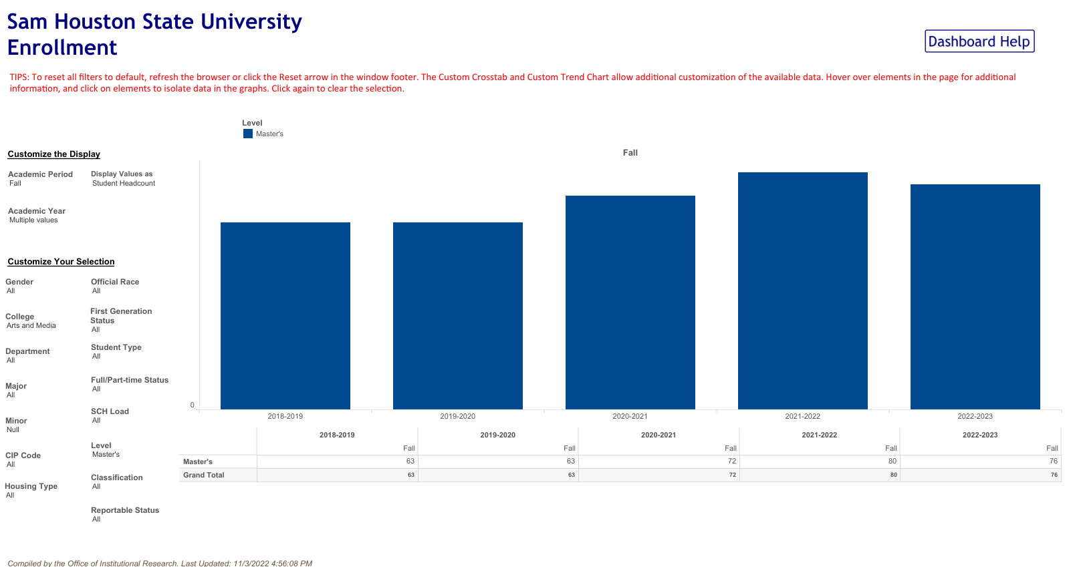
Supportive Data
17.1% enrollment growth

Slide 13
Budget Request
#4 Budget Priority
What is the request?
#4 Budget Priority | Studio Production Technician (Full Time Staff, MCOM)
Aligned with Strategic Priority Goal | Strategy 4: Expand and elevate our service to the State and beyond. Goal 4.1 - Promote career readiness and attainment through experiences that facilitate personal and professional development and connections.
Amount Requested | $72,600
Frequency of Need | Recurring
Opportunity Statement | This position will have far-reaching benefits for the university, our students, and the wider community. This position will enable us to expand and elevate our services in media production and distribution, including student training in media technology.
Risk Statement | Failure to fund this position will not address the need to provide oversight of media production technologies. This, in turn, will negatively impact student learning, and unit reputation, as prospective students may choose to attend institutions with better access to equipment.

Slide 14
Budget Request
#5 Budget Priority
What is the request?
#5 Budget Priority | Audio Production Technician (Full Time Staff, MUS)
Aligned with Strategic Priority Goal | Strategy 2: Embody a culture of excellence. Goal 2.2 - Align processes and resources, such as staffing, facilities, technology, and other assets to strategic priorities.
Amount Requested | $72,600
Frequency of Need | Recurring
Opportunity Statement | This position will be instrumental in managing audio recording production for all CAM performances, particularly in the School of Music. Recordings will be made available to the public, providing a unique opportunity to promote our music programs both within and beyond the state of Texas. This position will provide invaluable experience and training opportunities for students interested in audio engineering and production.
Risk Statement | Failure to fund this request may result in lost revenue from missed opportunities due to the lack of high-quality recordings (alumni, donor, and patron support). Additionally, the absence of this position will limit our ability to support new degree programs in audio music recording, podcast journalism, and film production.

Slide 15
Summary of Budget Requests
Art Faculty - $381,152
Mass Comm Faculty – $157,841
Graduate Funding – $100,000
Studio Production Tech – $72,600
Audio Production Tech – $72,600
*Total Amount Requested – $784,193

Slide 16
Prospective “Big Ideas”
External Funding: Sponsorships, Patrons and Donors, Grants
Academic Goals: Build out "Workforce Ready" degrees, minors, certificates, and badges
A Life of Service: Build out ACE classes and community partnerships
Renovations: Art Research Building, Dan Rather Communications Building, School of Music Practice Studios
Partner with SHSU Online to build Bearkat Network

Slide 17
Questions?

